Slide 1

Individual Homework – Resolution Proposition
Cantor Dan-Alexandru 912 Group

Slide 2
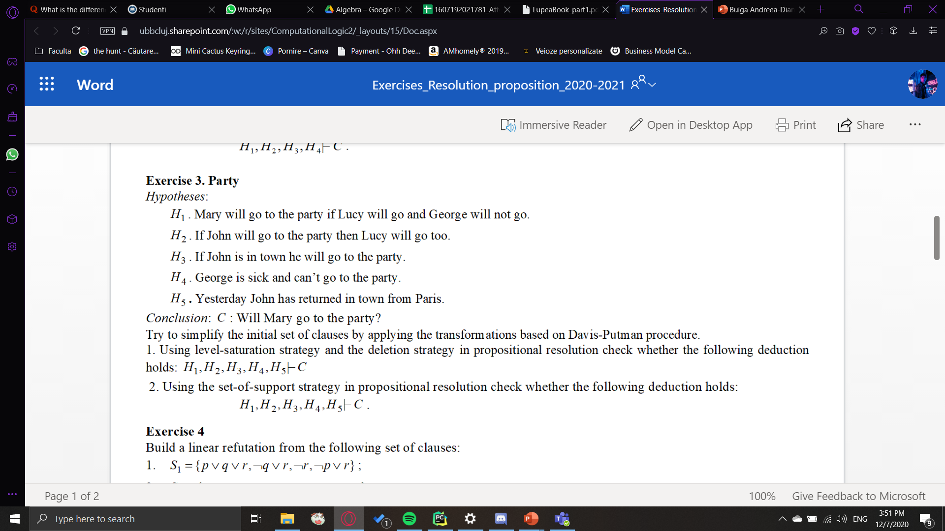
Exercise 3.2
01

Slide 3
Theoretical results

Slide 4
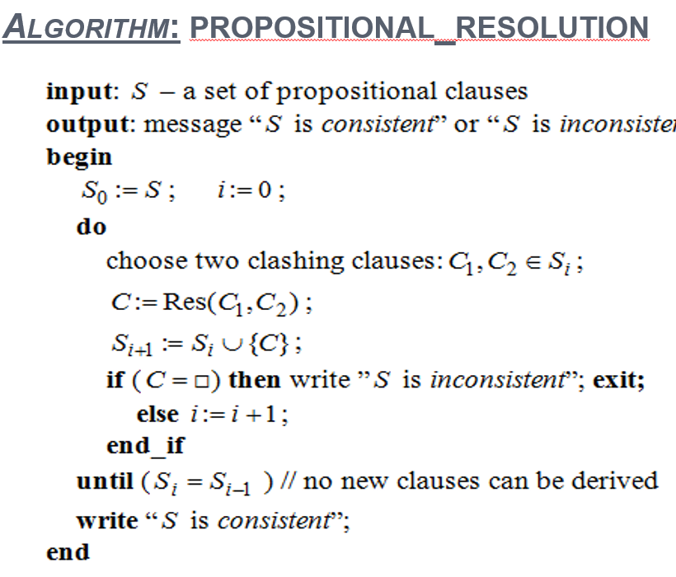
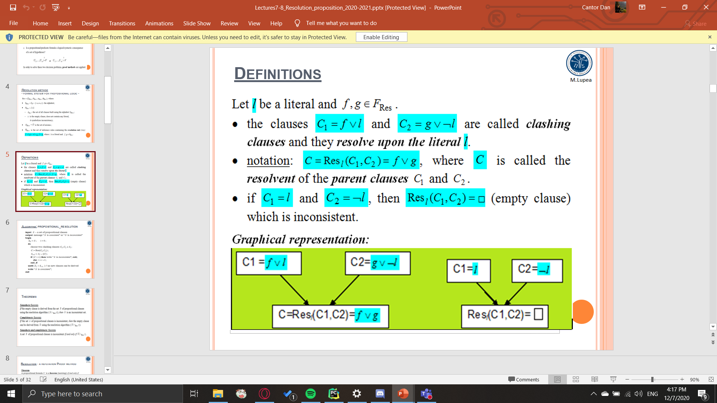
How resolution method works?
The algorithm for resolution proof method implies resolving all the clashing clauses until we obtain the empty clause (in this case we have an inconsistent formula) or otherwise, a consistent one

Slide 5
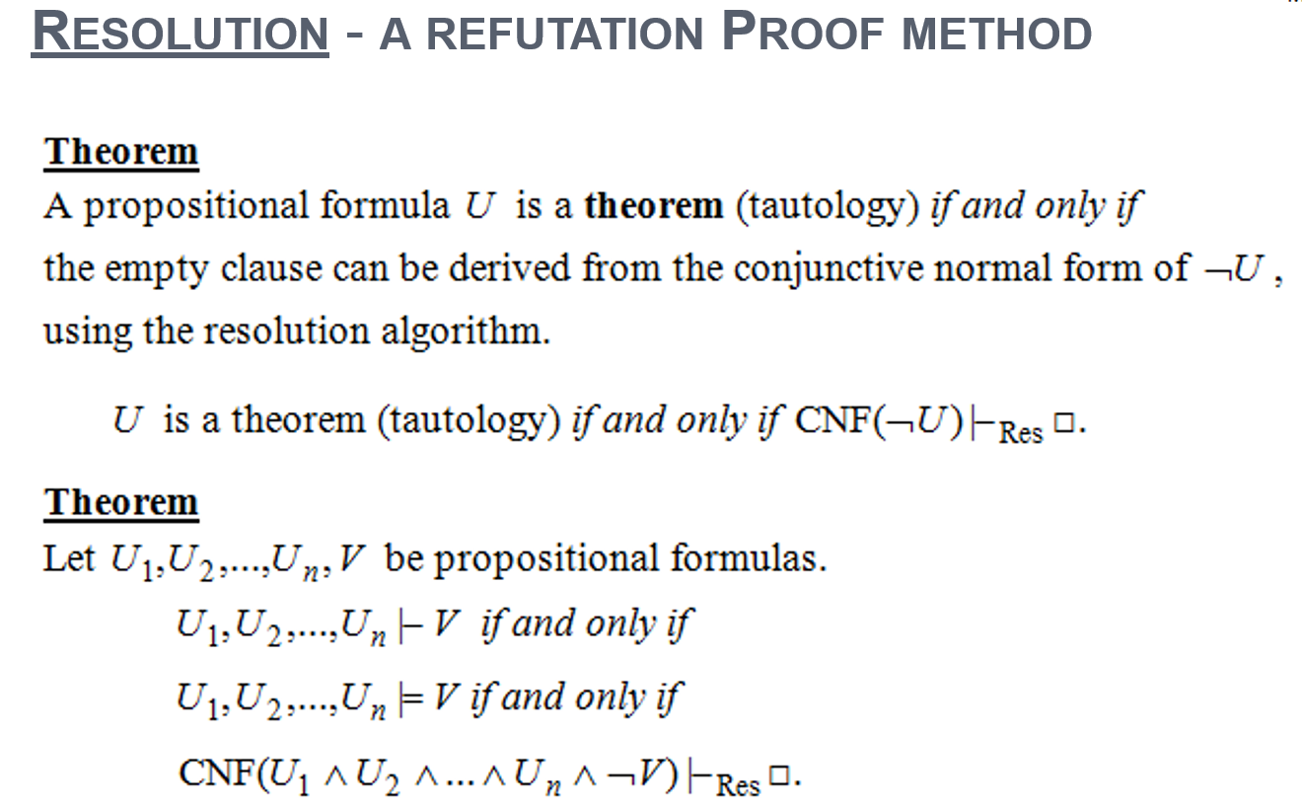
Resolution as a reputation proof method

Slide 6
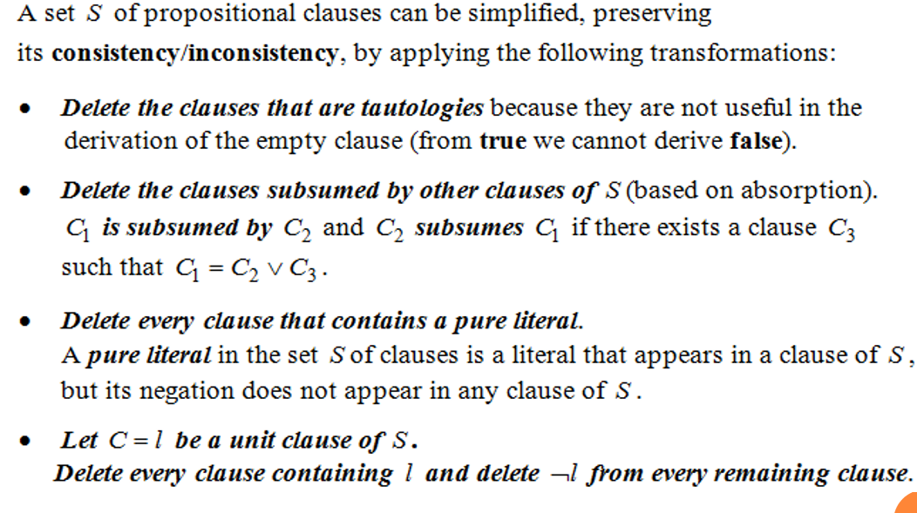
Simplifications by Davis-Putman procedure

Slide 7
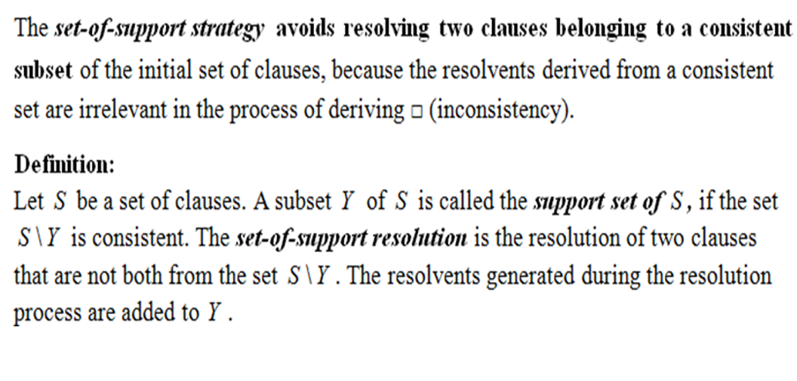
Set-off-support strategy

Slide 8
Exercise 3.2 Solution

Slide 9
Notations for the propositional variables: M – Mary will go to the party L – Lucy will go to the party
G – George will go to the party
J – John will go to the party
Jt – John is in town
Gs – George is sick
Propositional formulas:
H1: L ˄ ¬G → M
H2: J → L
H3: Jt → J
H4: Gs ˄ ¬G
H5: Jt
C: M
Transforming initial formulas in clauses:
H1 ≡ ¬L v G v M (C1)
H2 ≡ ¬J v L (C2)
H3 ≡ ¬Jt v J (C3)
H4: ¬G (C4)
H4: Gs(C5)
H5: Jt(C6)
¬ C: ¬M (C7)
In order to check if the deduction holds, we need to prove that:
CNF(C1 ˄ C2 ˄ C3 ˄ C4 ˄ C5 ˄ C6 ˄ C7) |-Res

Slide 10
C1: ¬L v G v M
C2: ¬J v L
C3: ¬Jt v J
C4: ¬G
C5: Gs
C6: Jt
C7: ¬M
Now we apply transformations based on Davis-Putman procedure:
We delete C5 because it is a pure literal
So:
C1: ¬L v G v M
C2: ¬J v L
C3: ¬Jt v J
C4: ¬G
C6: Jt
C7: ¬M
X’ = {C1, C2, C3, C4, C5, C6, C7}
We choose Y = {C7} as a support set of S, corresponding to ¬C (the negation of the conclusion of deduction). S \ Y = {C1, C2, C3, C4, C5, C6} is a consistent set corresponding to the premise of the deduction.

Slide 11
C1: ¬L v G v M
C2: ¬J v L
C3: ¬Jt v J
C4: ¬G
C6: Jt
C7: ¬M
X’ = {C1, C2, C3, C4, C5, C6, C7}
Y = {C7}
C8: Res_{p} (C3, C4) = ¬L v M Y = {C7, C8}
C9: Res_{p} (C8, C7) = ¬L Y = {C7, C8, C9}
C10: Res_{p} (C9, C2) = ¬J Y = {C7, C8, C9, C10}
C11: Res_{p} (C10, C3) = ¬Jt Y = {C7, C8, C9, C10, C11}
C12: Res_{p} (C11, C6) =
In conclusion, because we obtain the empty clause, we can deduce that X is inconsistent, so the initial deduction holds.

